Slide 1
Scraping: Gotta Catch 'em All
Credit: Ryan Little's NICAR 23 Lightning Talk

Slide 2
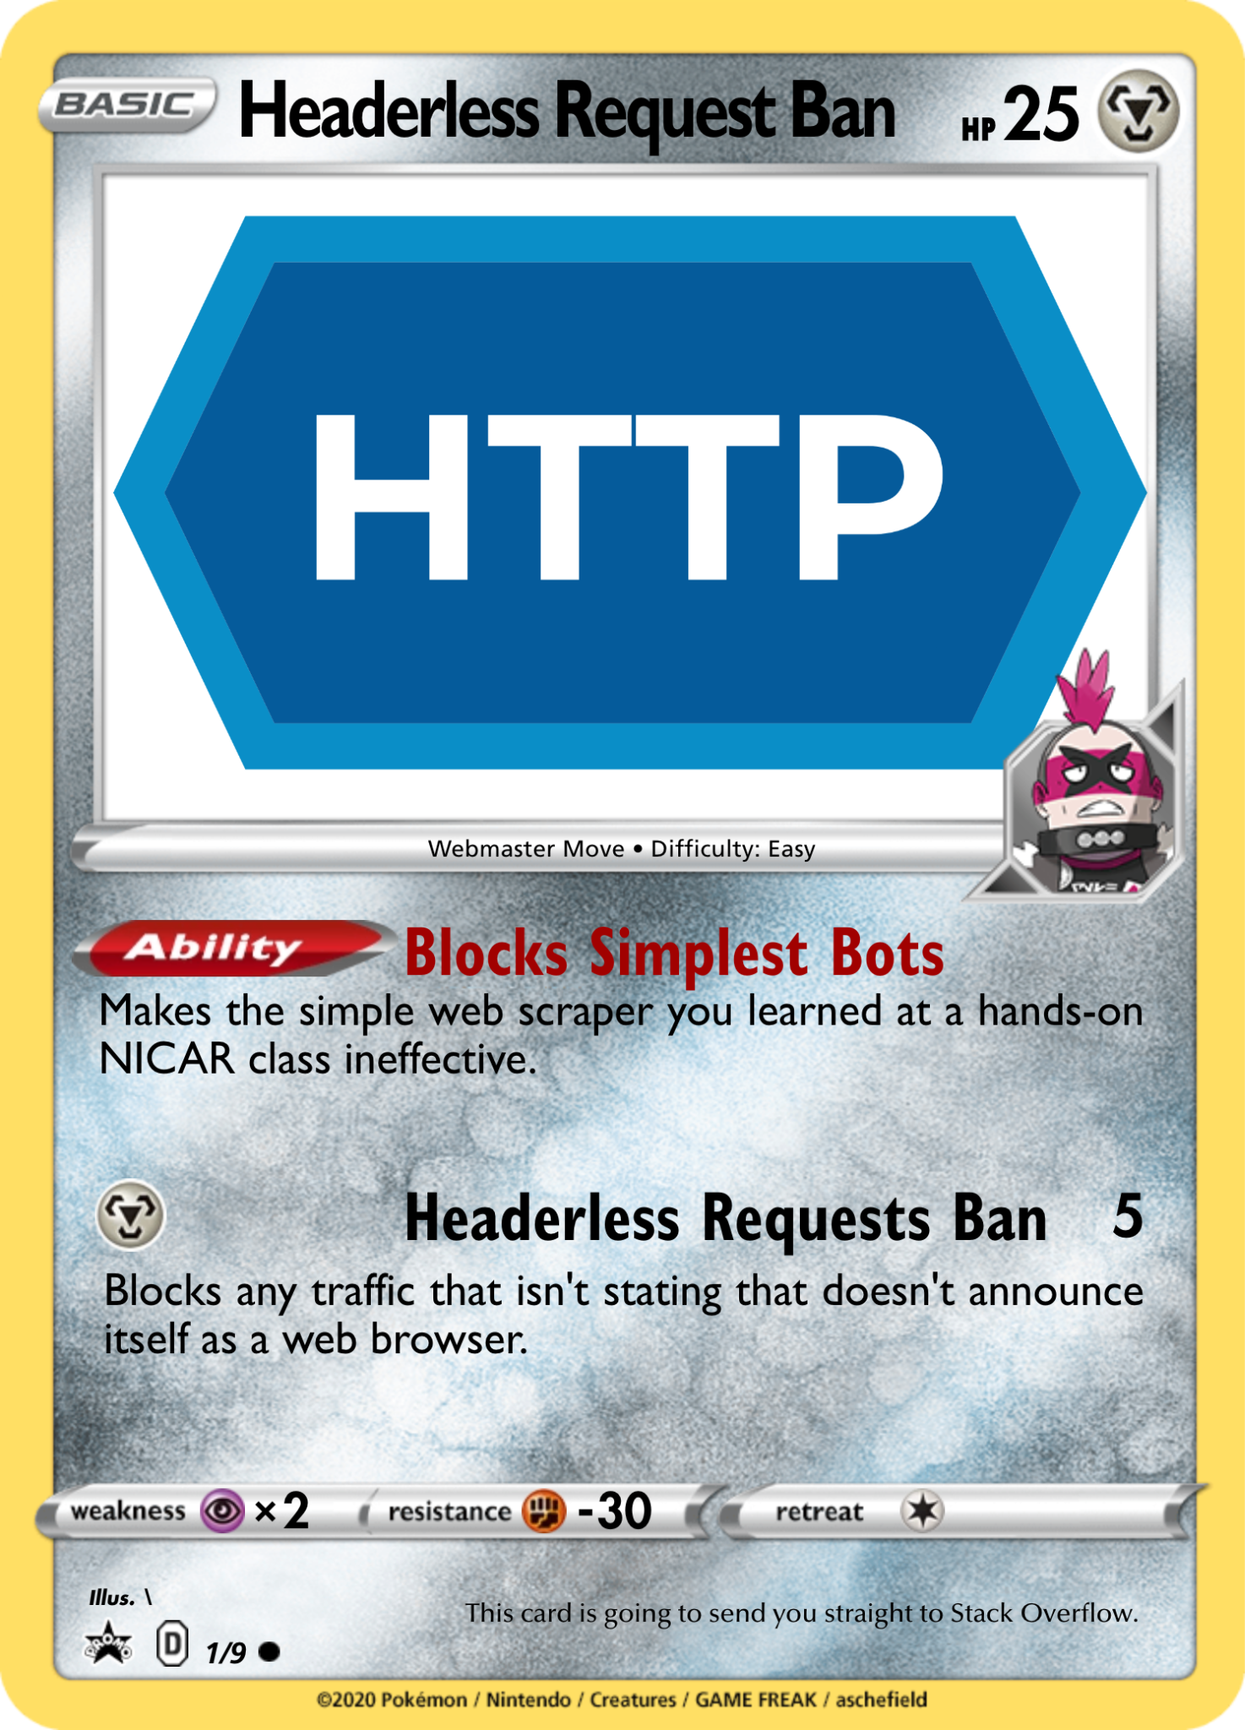
Example 1
Example 2

Slide 3
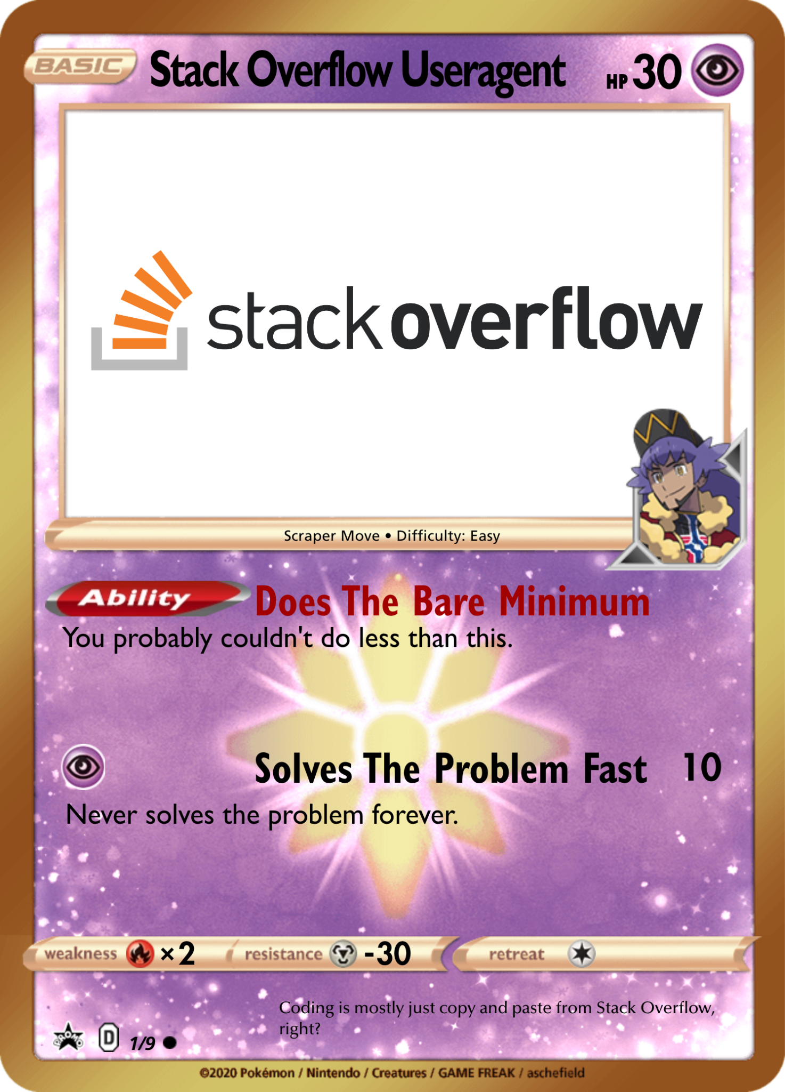
You've basically copied a single user agent from your own web browser or somewhere posted on the internet.

Slide 4
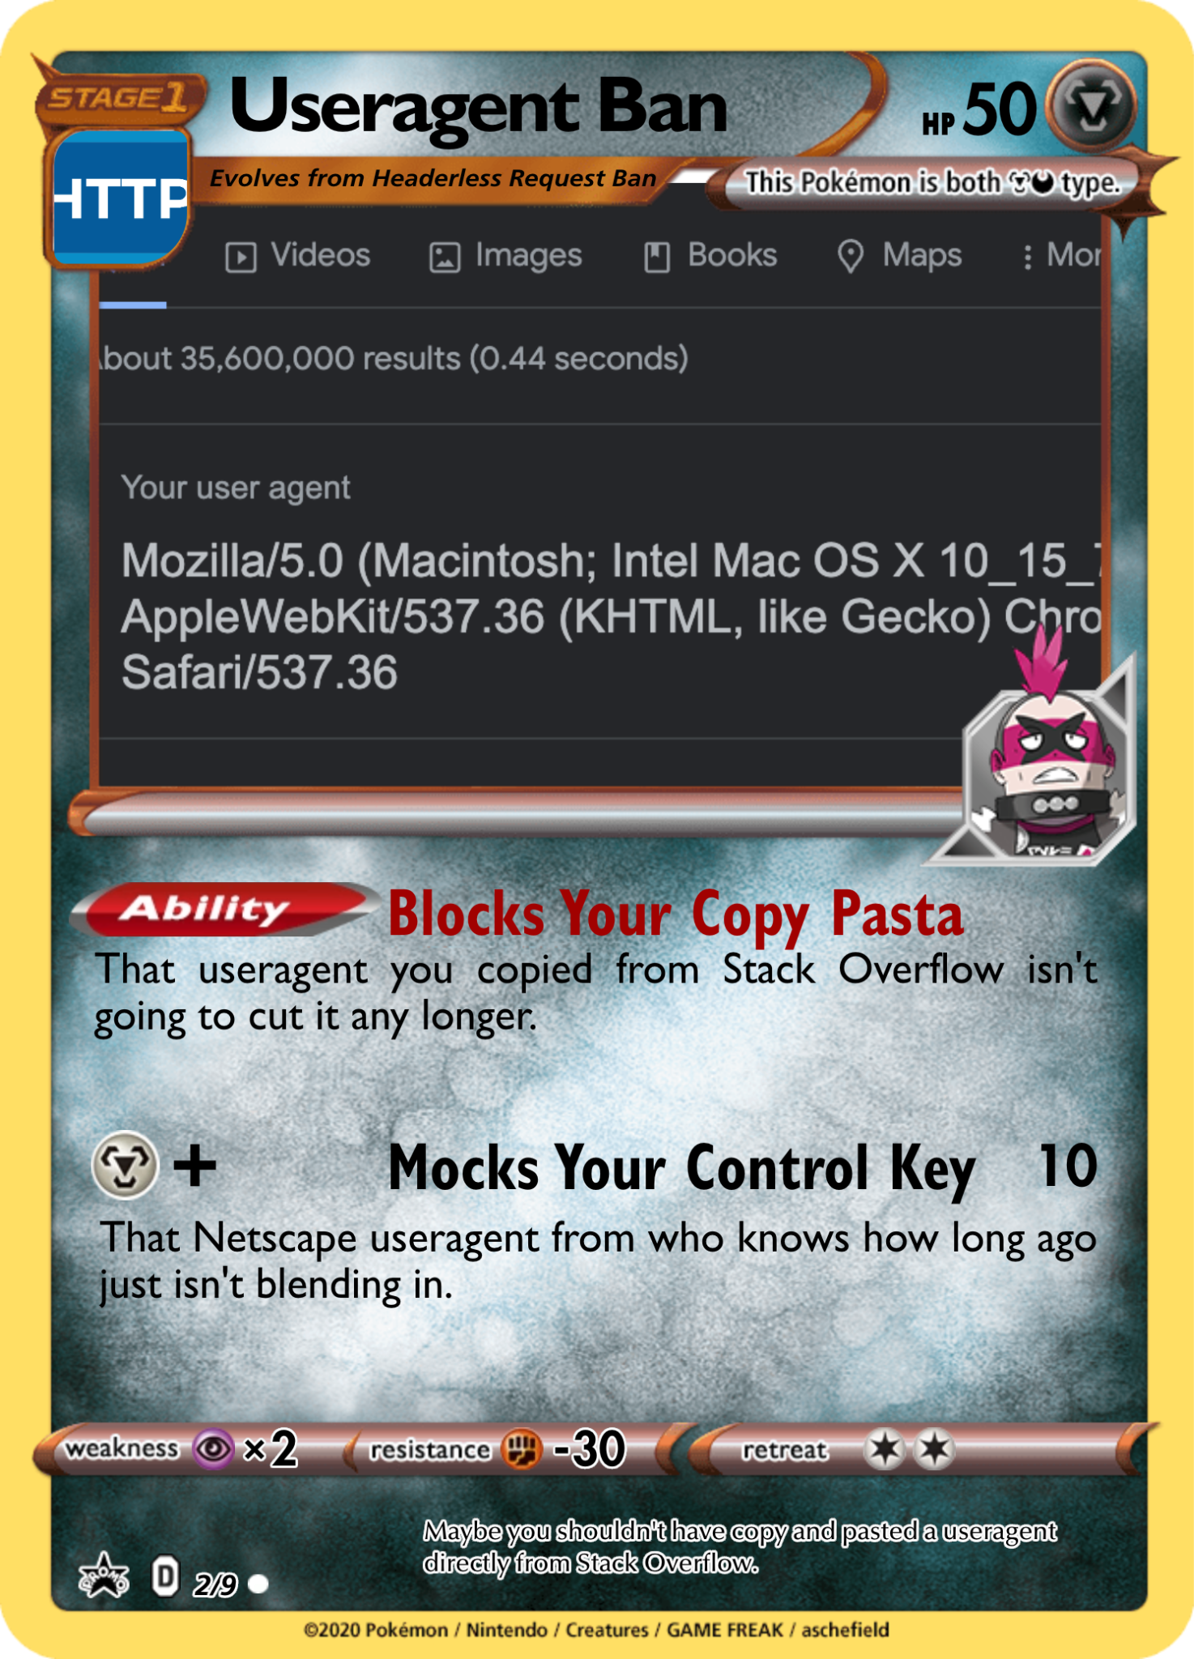

Slide 5
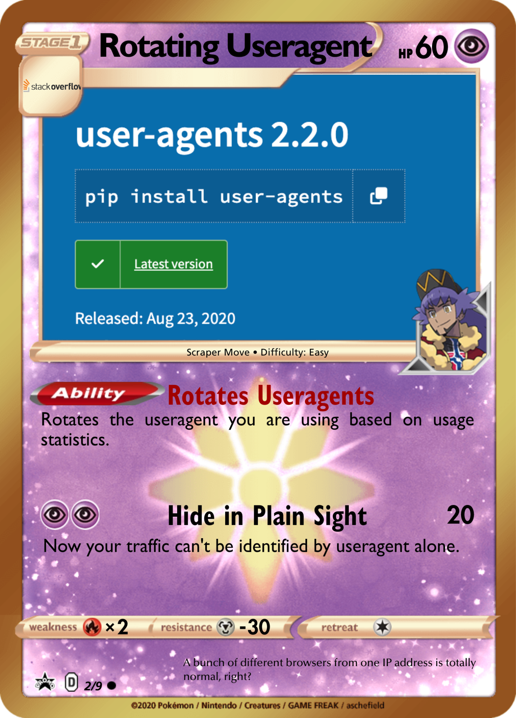
useragentstring.com
fake-useragent
Rotating IP and user agent

Slide 6
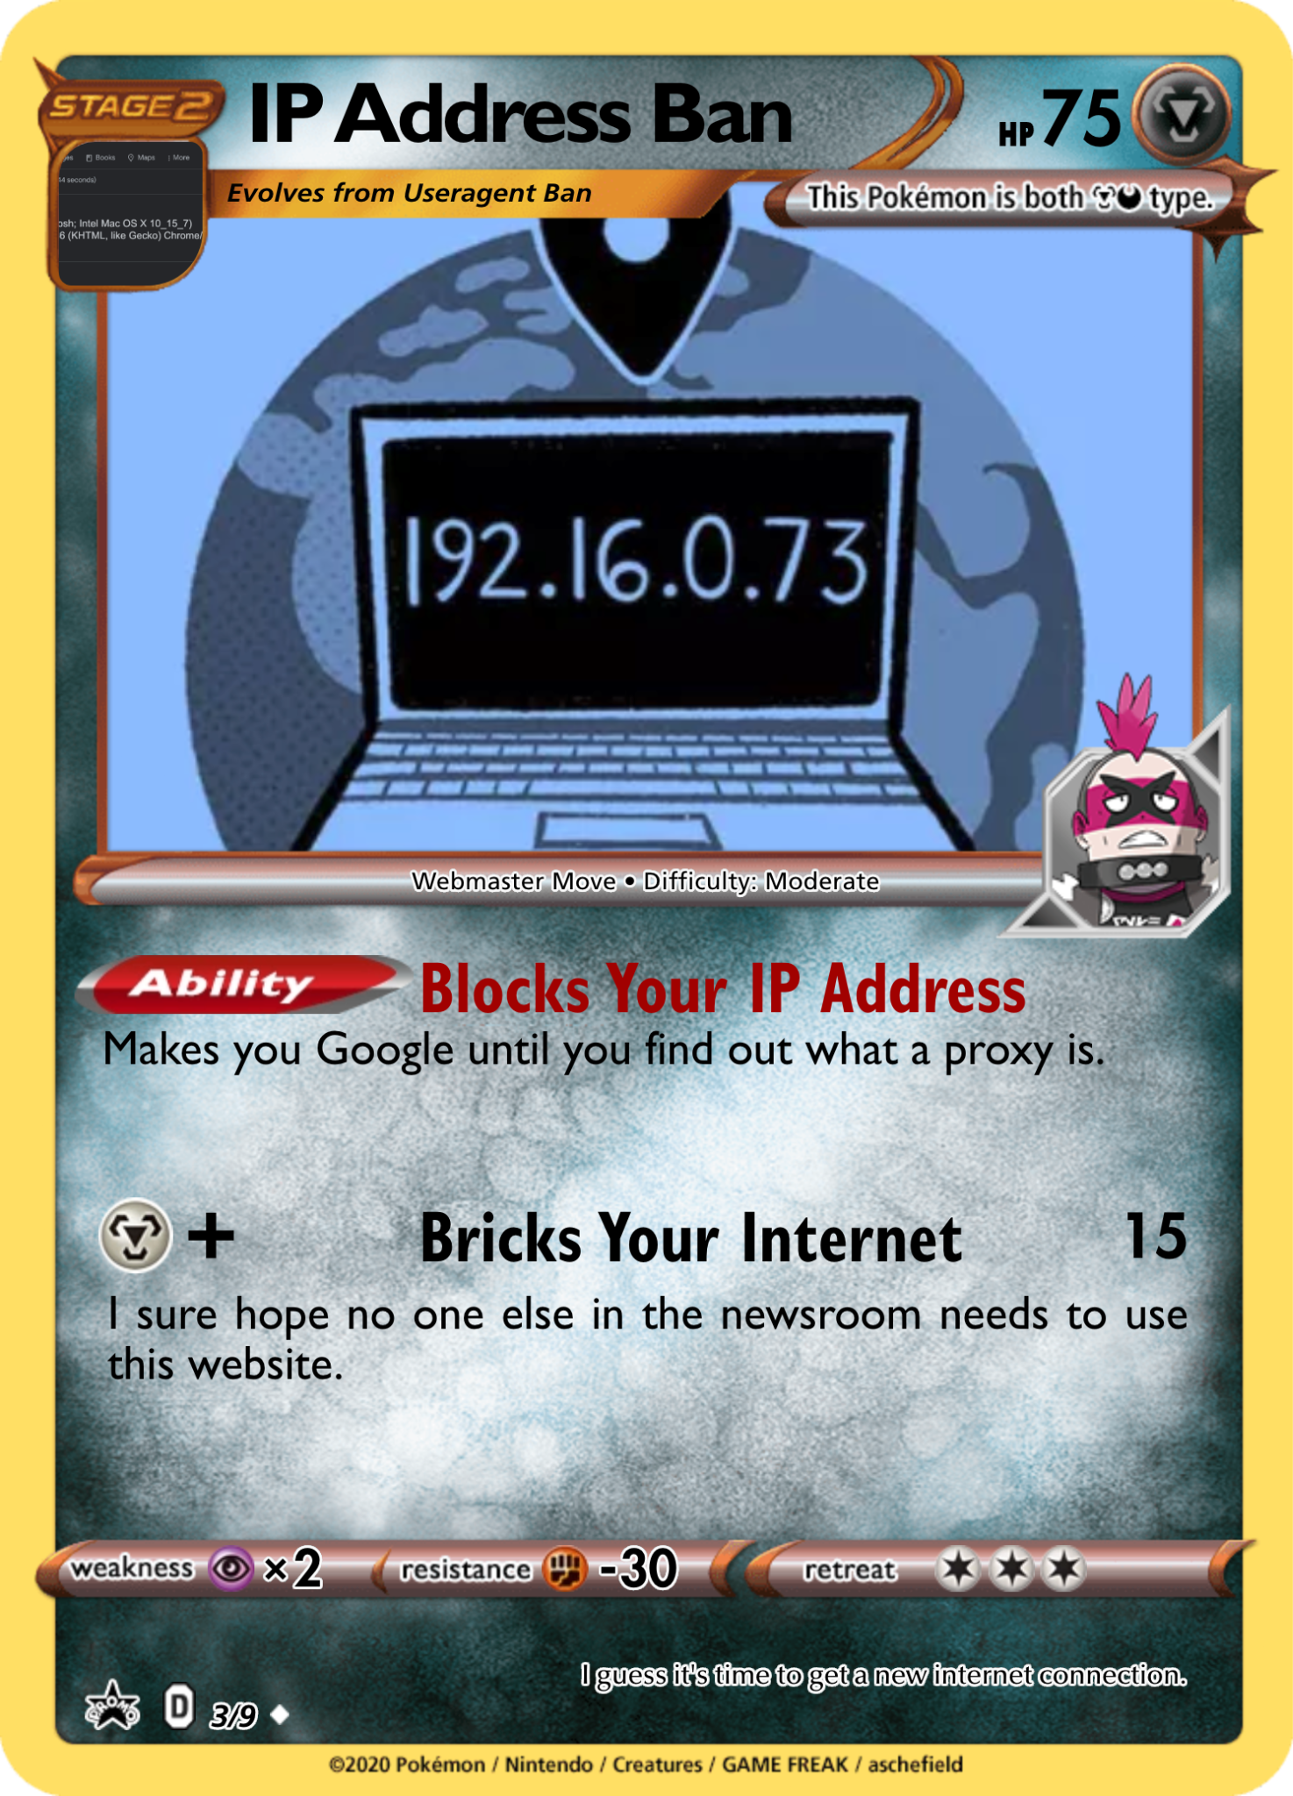

Slide 7
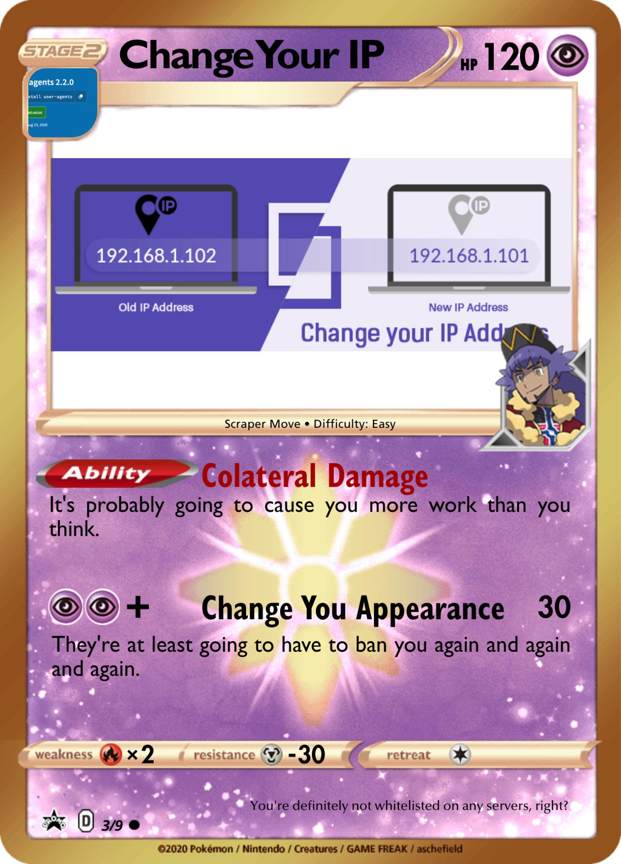
We could rotate our IP address with a VPN, but those will likely be blocked soon enough as well.

Slide 8
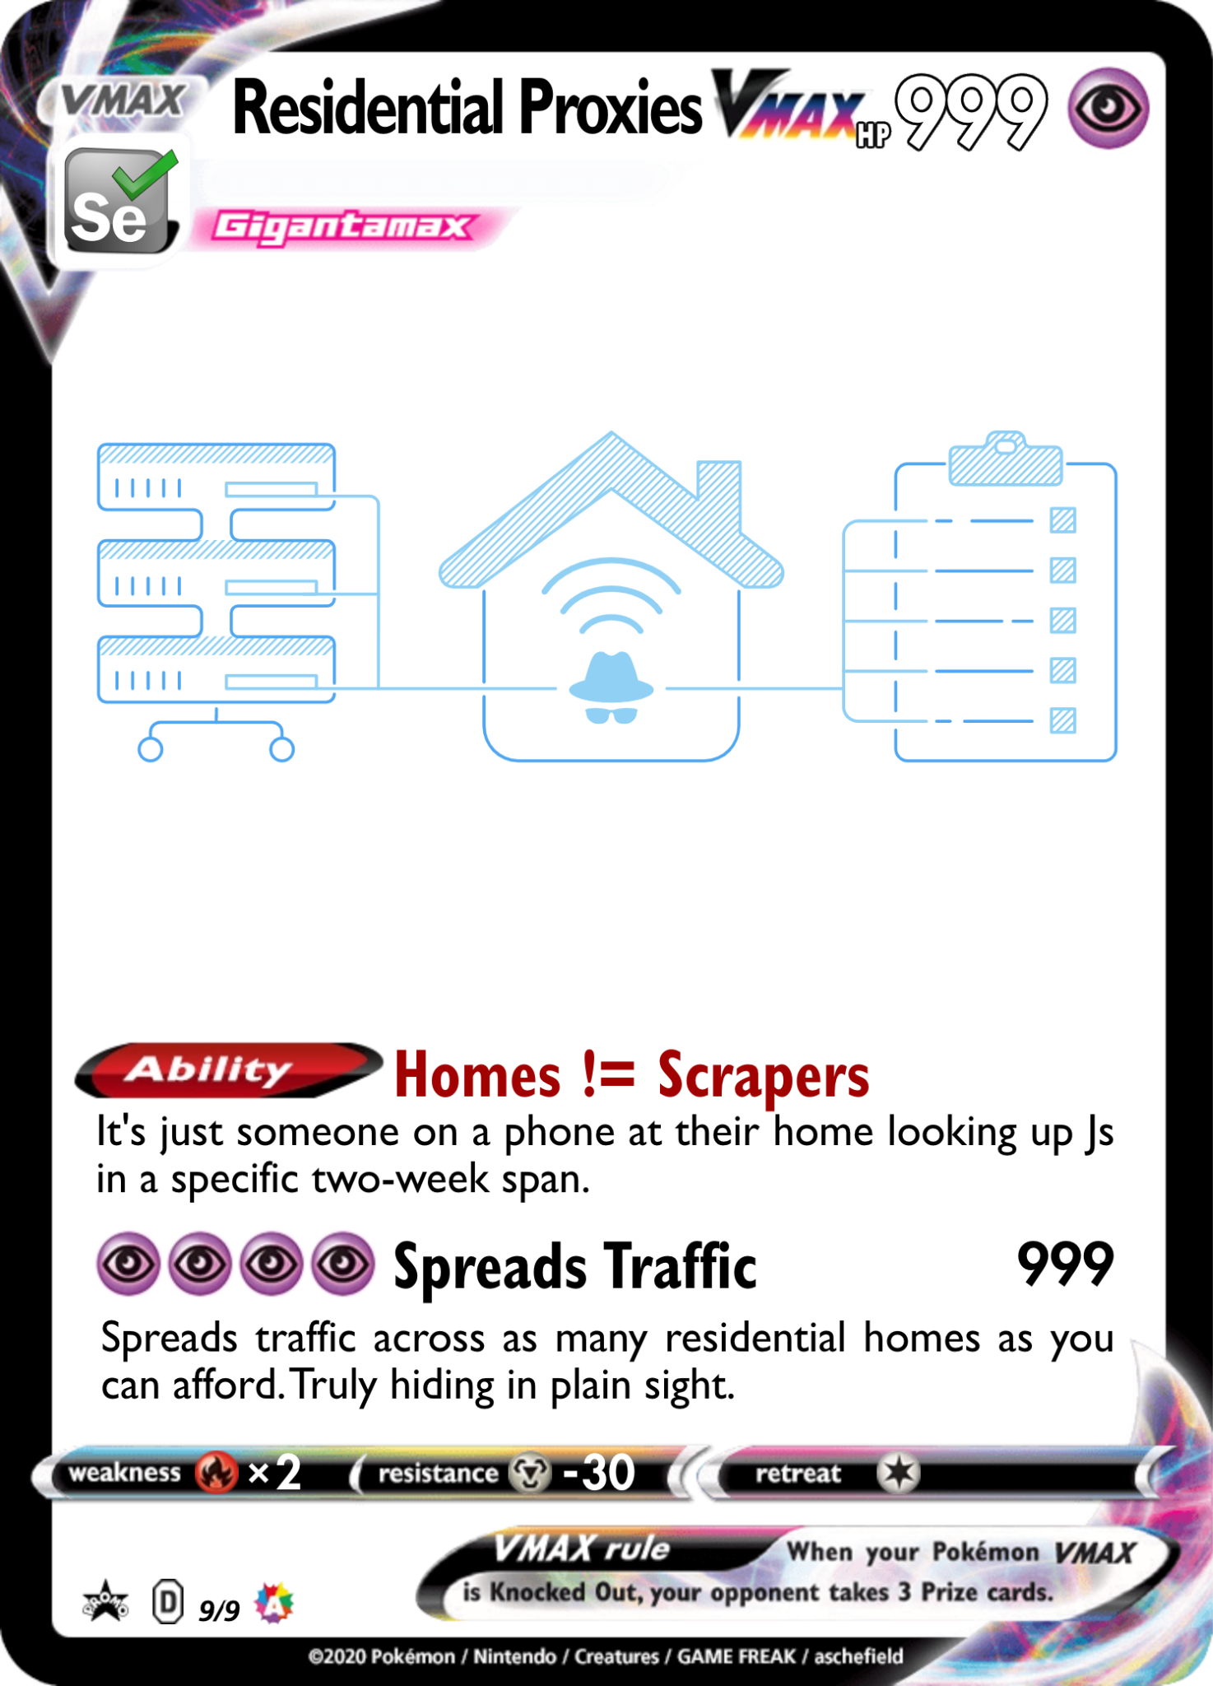

Even better than a single IP change is if we can have several IP addresses in a pool, especially ones that make us look like we are making requests from residential areas or from mobile devices.
Residential proxies like IPRoyal allow us to do that. There are free proxies, but often system administrators scrape those free proxy lists and preemptively ban them.
There are also mobile proxies, which make the request look like they come from a mobile plan.
This works even better when combined with spoofing the user agents to appear like phone web browsers.

Slide 9
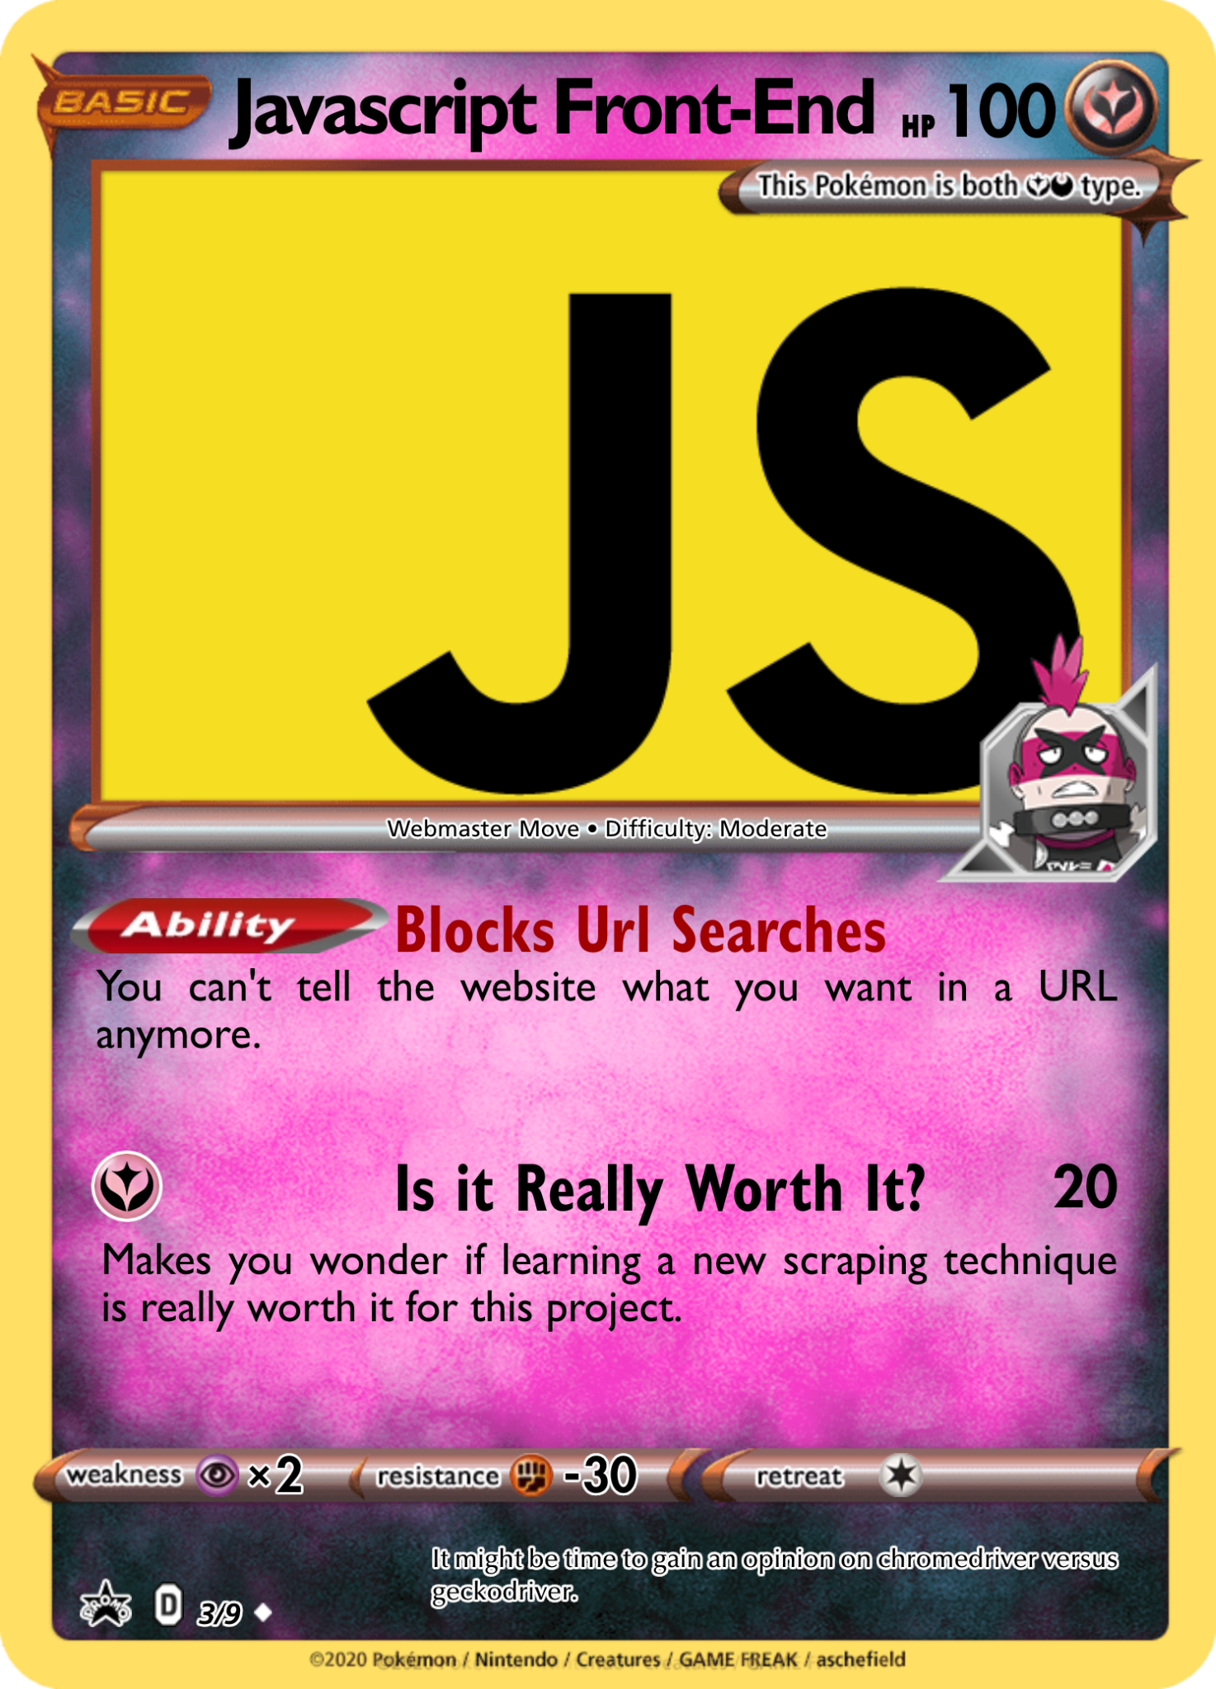
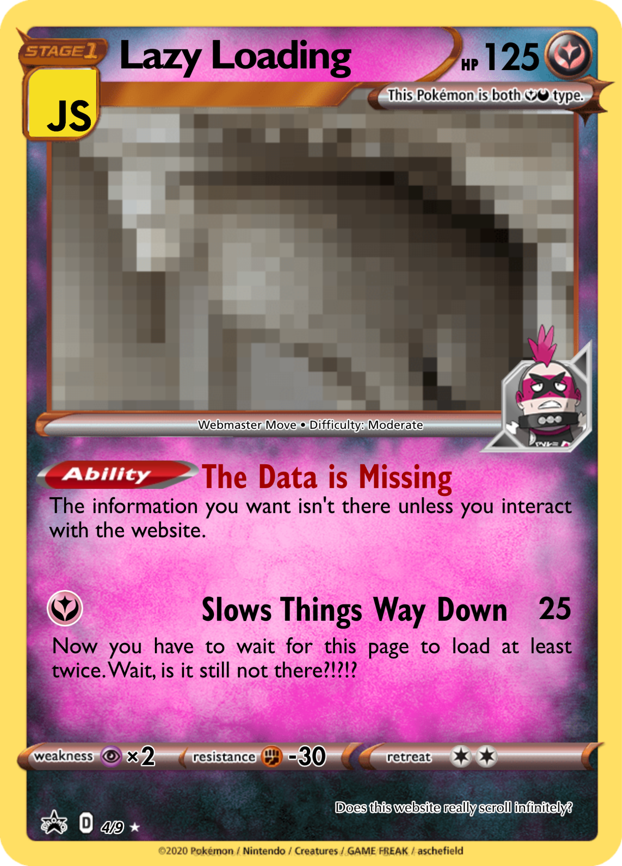
Example

Slide 10
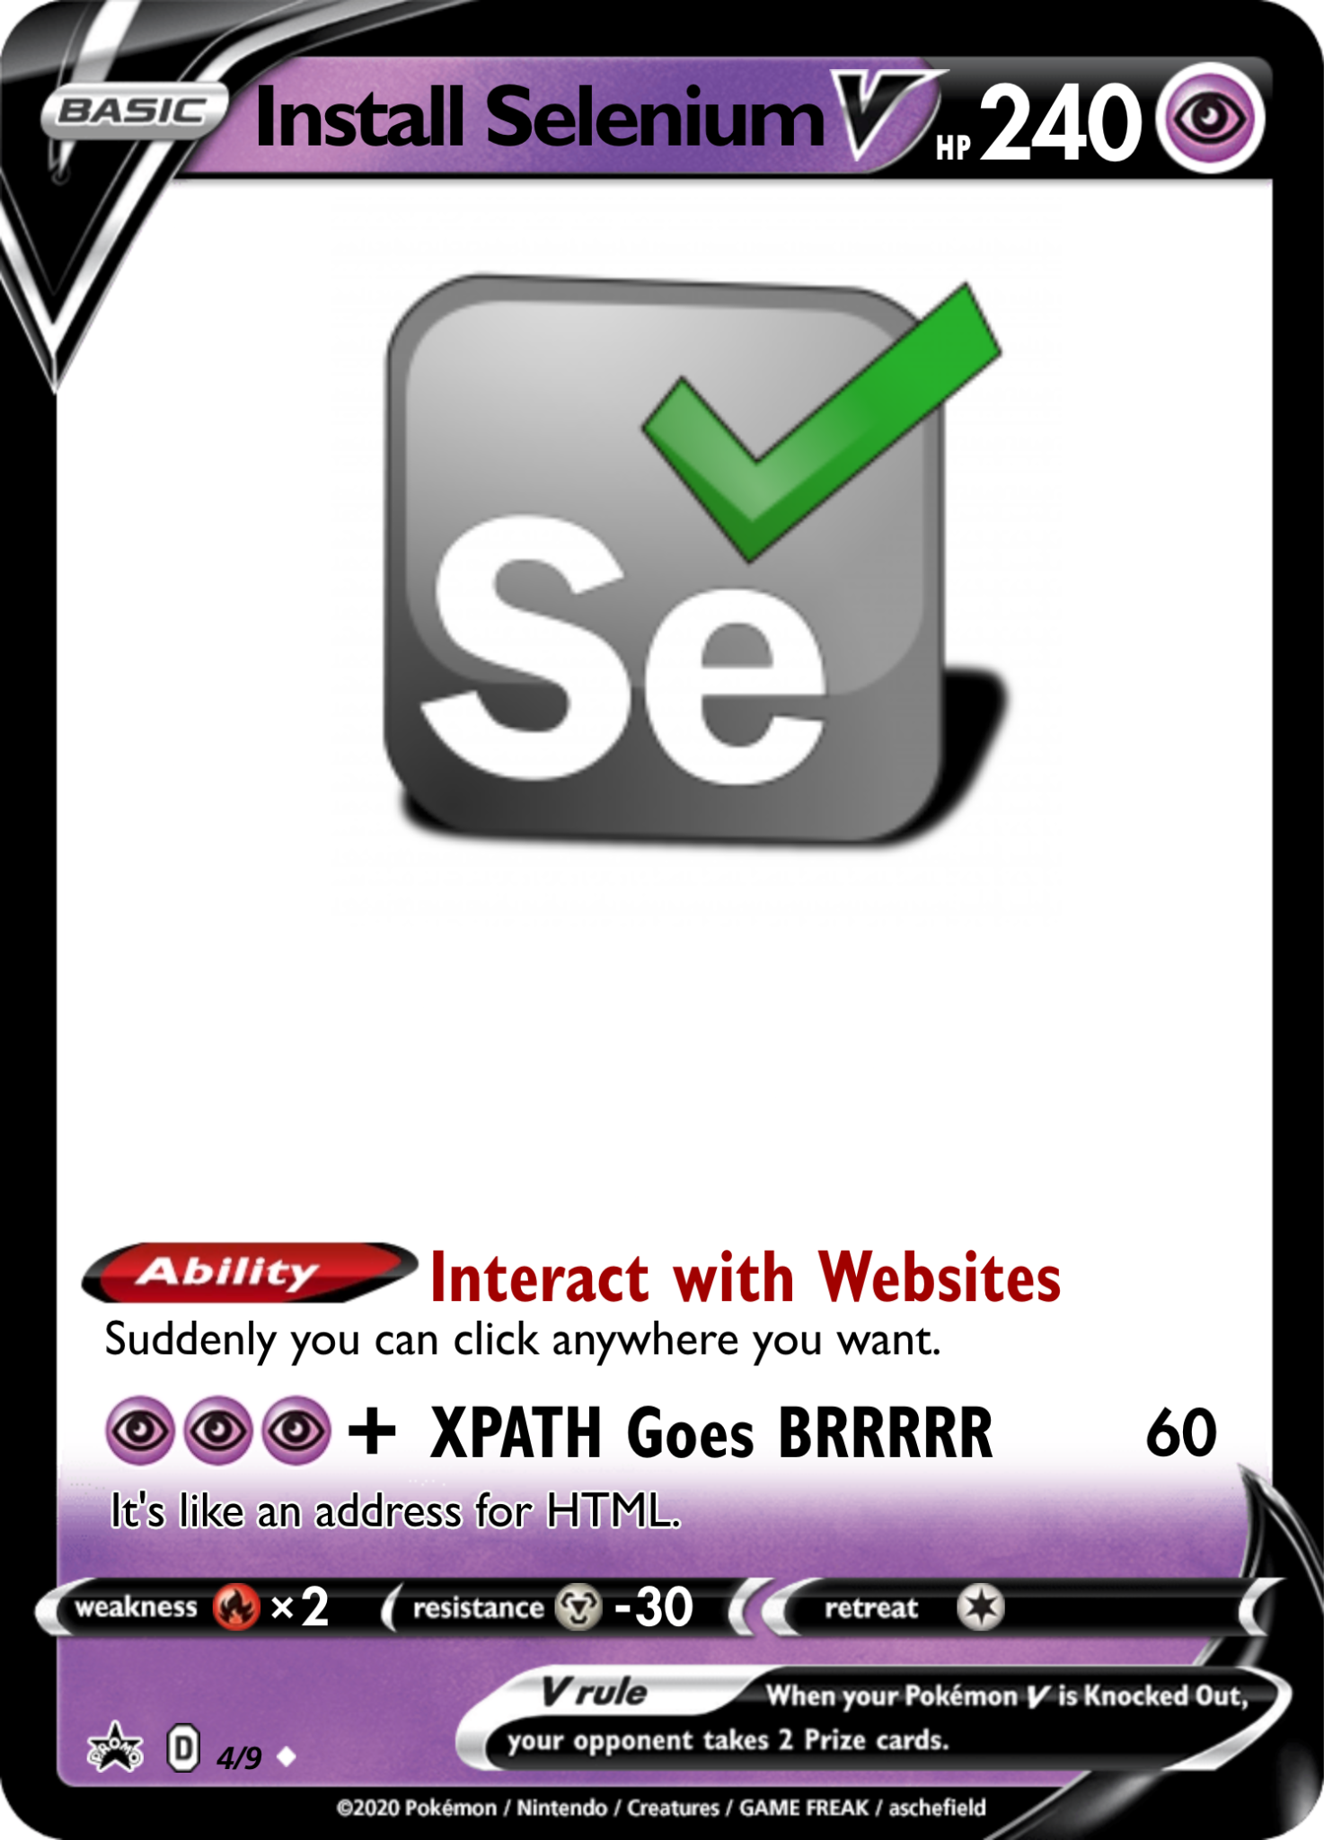
More info on making Selenium stealthy

Slide 11
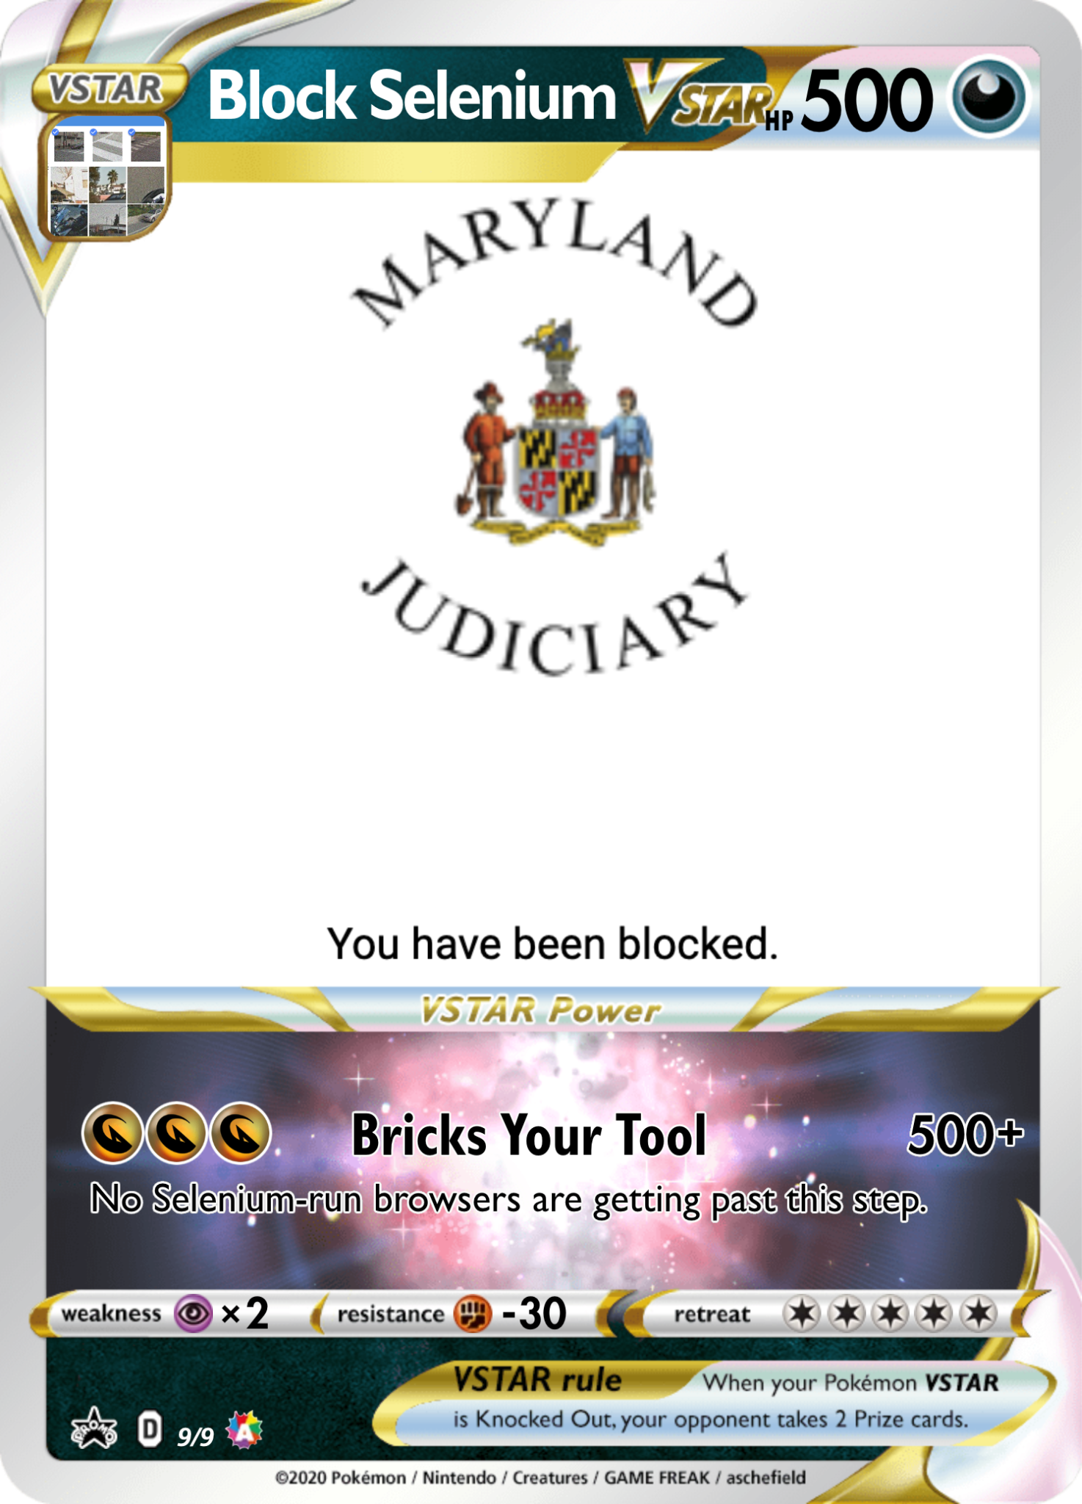
Example

Slide 12
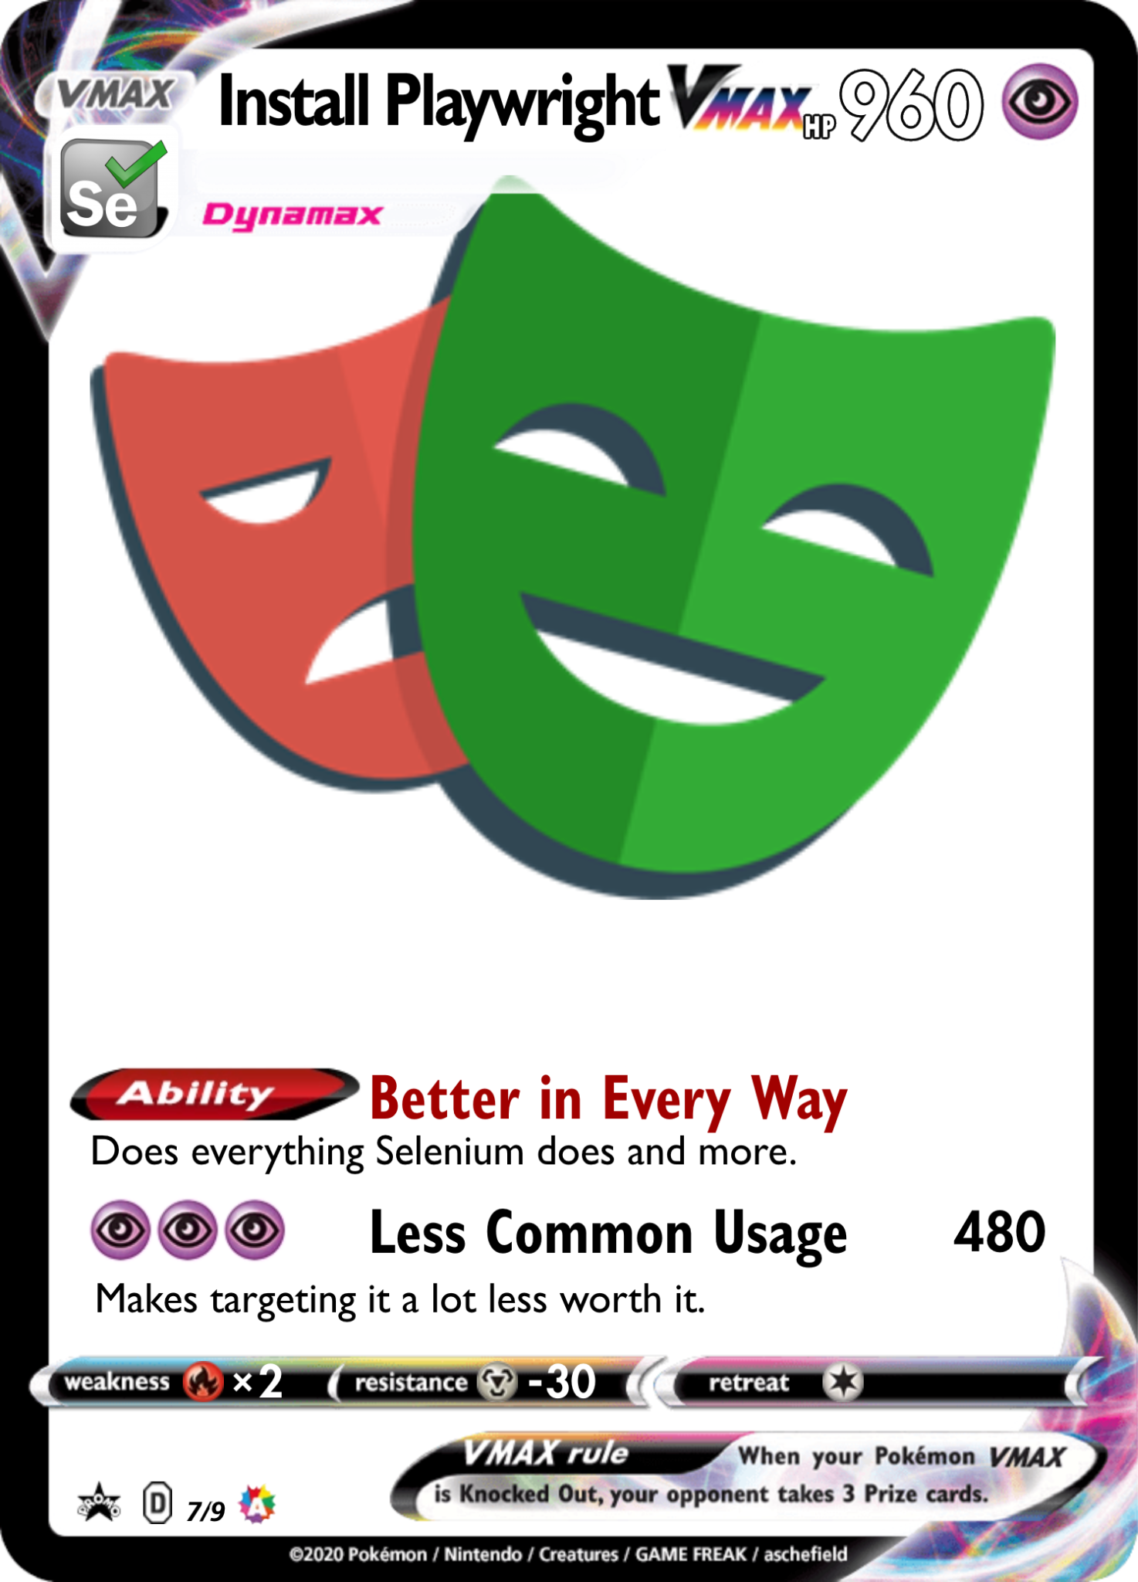
Some benefits of Playwright
Installation
Generate tests instead of looking in devtools

Slide 13
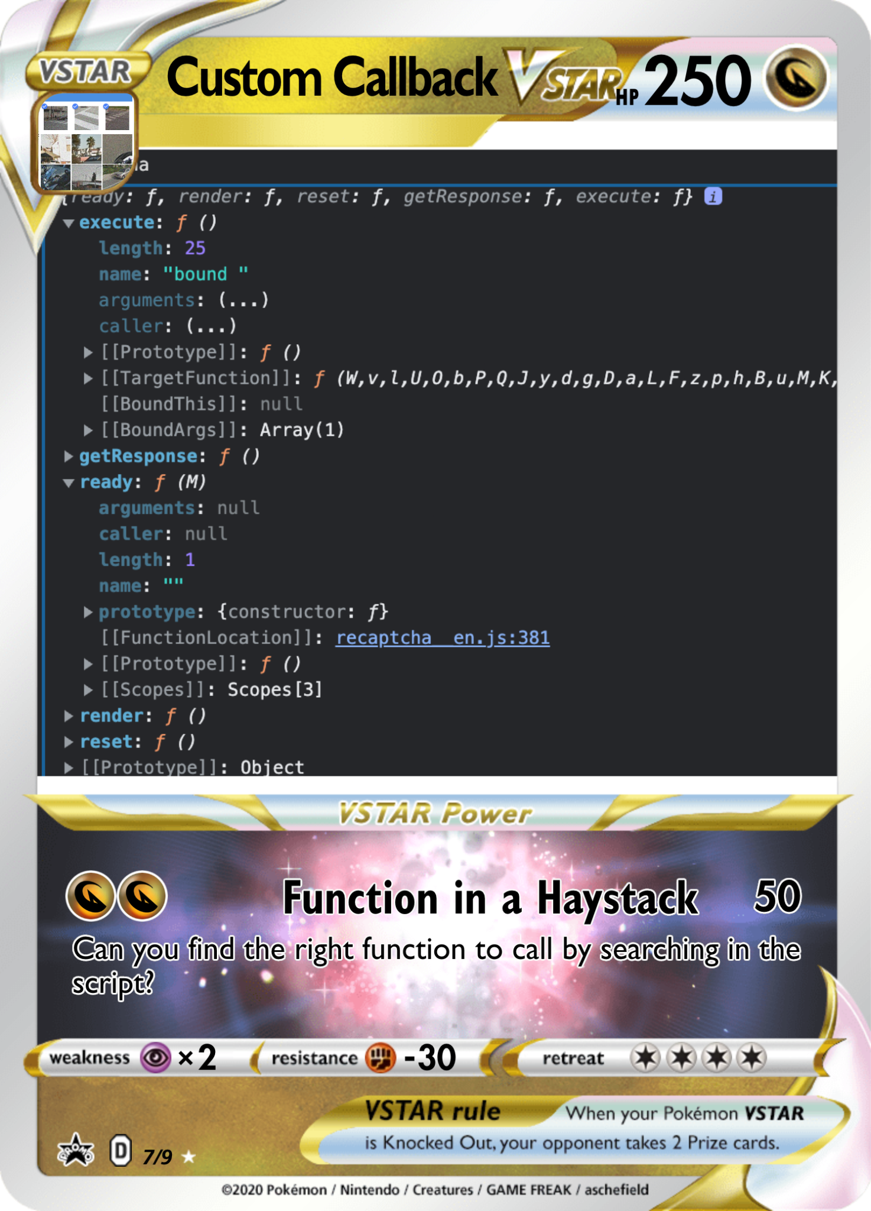
Example

Slide 14


Slide 15
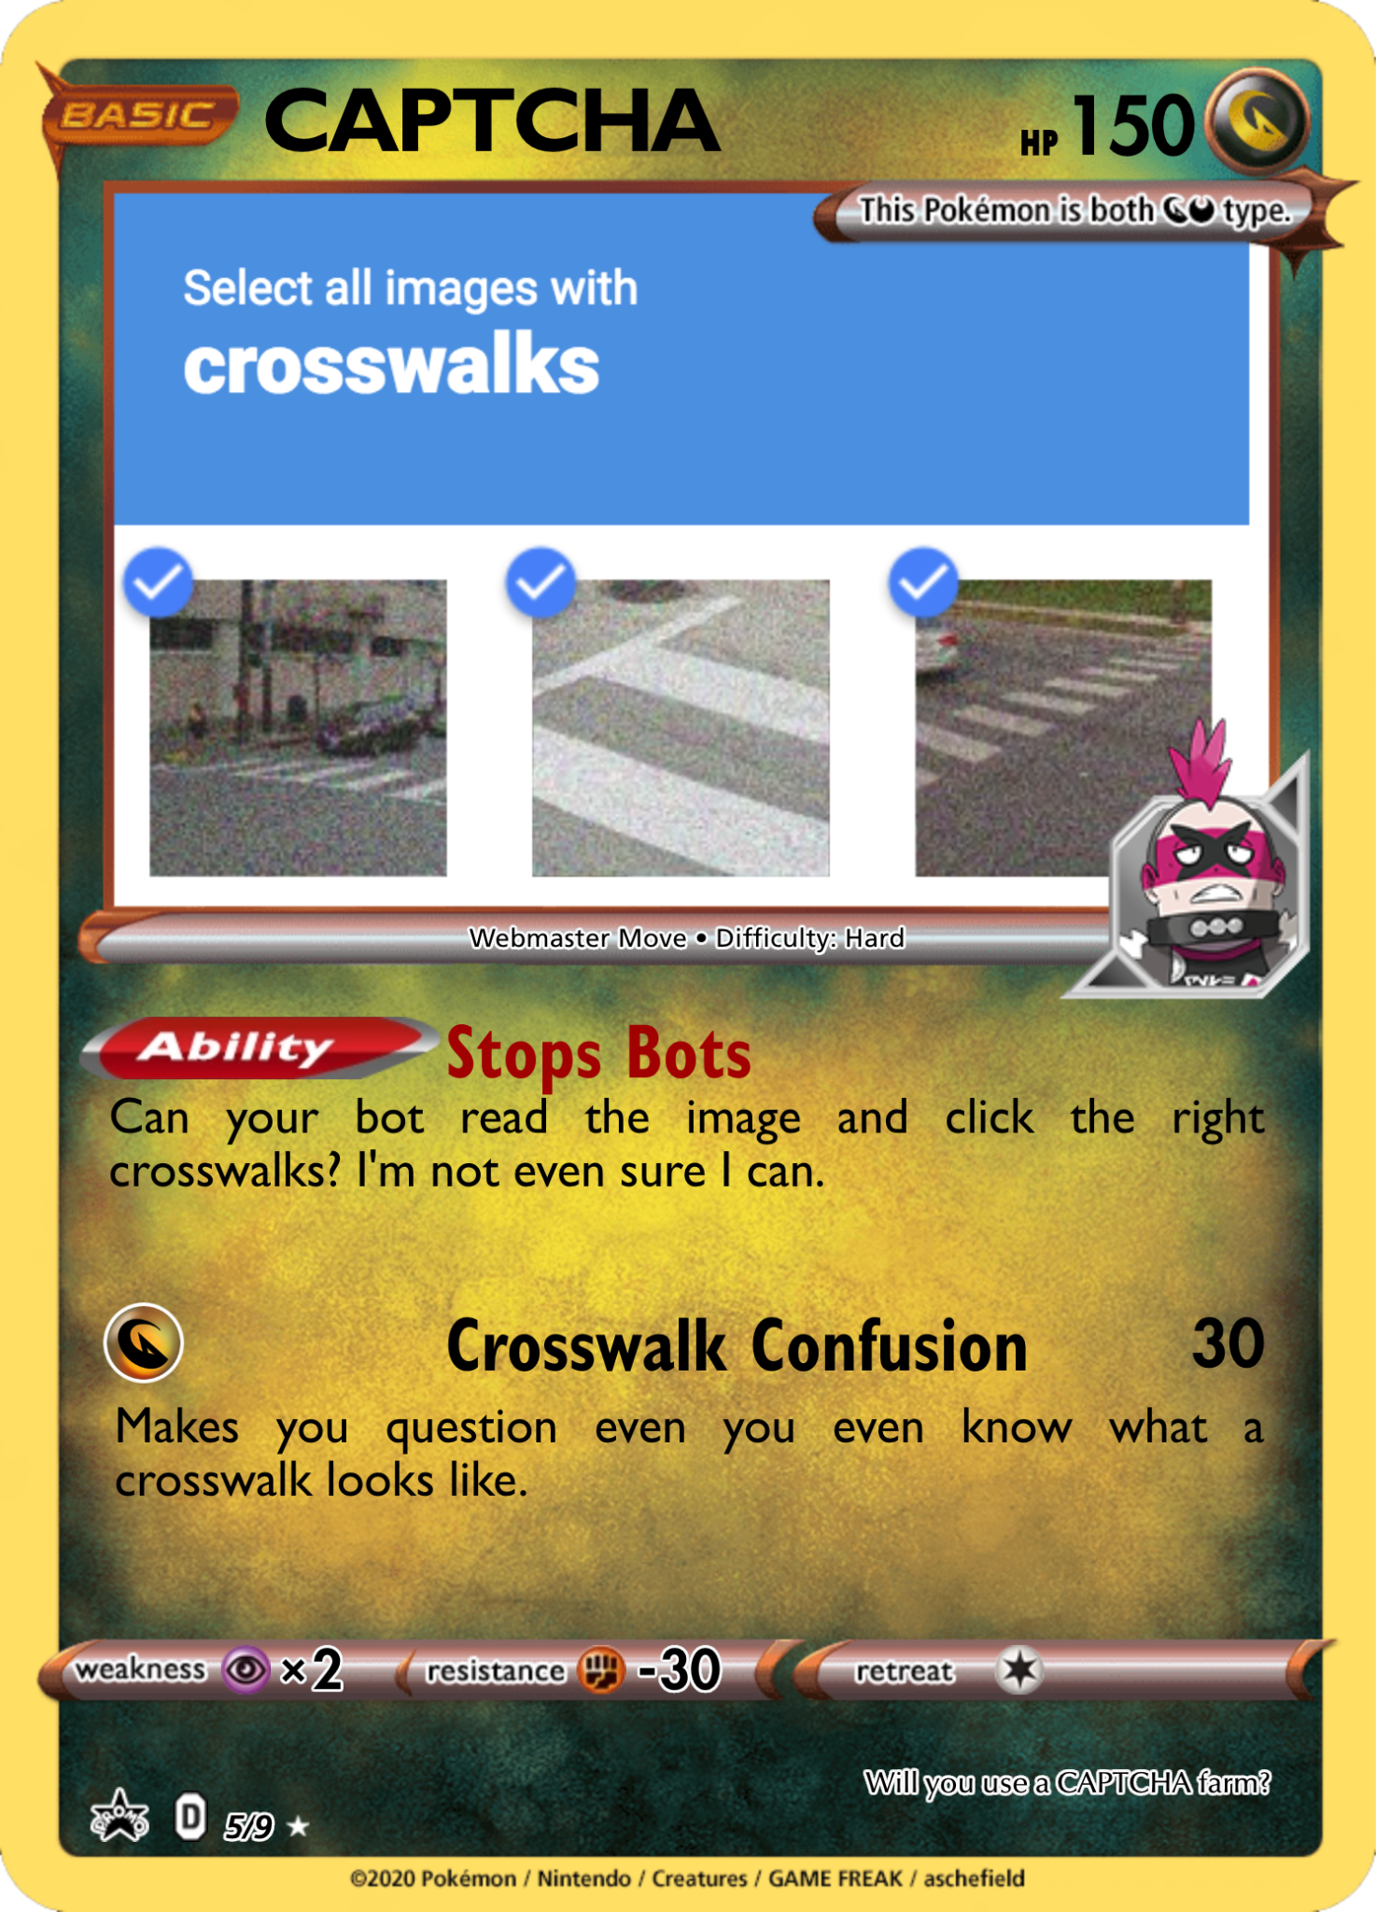

Slide 16
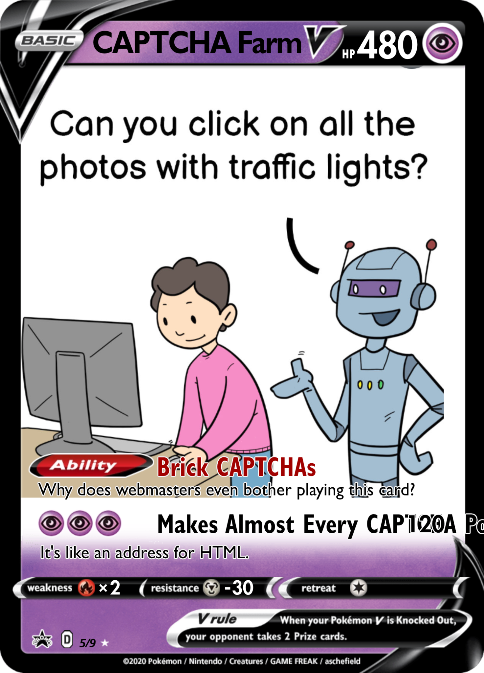

Slide 17

Example
There is an arms race between AI tools that solve CAPTCHAs and new types of CAPTCHAs. There are services where you have an API key and pass CAPTCHAs that need to be solved and get the solution in return. They include browser extensions.

Slide 18
More useful scraping tutorials
Scrapism
Playwright Tutorial
Leverage IP Address Rotation
Playwright for Web Testing
Playwright with form authentication for scraping

